Slide 1
SQL
Submitted By
Maimoona Khilji

Slide 2
Content
What is DML, DQL and DDL?
What are sub-queries? (in detail)
What are Views & stored Procedures?
How can you apply conditions using SQL and how can you define UDF (user defined functions) in SQL.
HackerRank solutions

Slide 3
Data Definition Language (DDL) Statements
DDL or Data Definition Language actually consists of the SQL commands that can be used to define the database schema.
It simply deals with descriptions of the database schema and is used to create and modify the structure of database objects in the database. It enable you to change the structure of the database.

Slide 4
Command | Description
CREATE | It is used to create the database or its objects (like table, index, function, views, store procedure and triggers).
ALTER | It is used to alter the structure of the database. It modifies an existing database object, such as a table.
DROP | It is used to delete objects from the database like an entire table, a view of a table or other objects in the database.
TRUNCATE | It is used to remove all records from a table, including all spaces allocated for the records are removed.
COMMENT | It is used to add comments to the data dictionary.
RENAME | It is used to rename an object existing in the database.

Slide 5
Data Manipulation Language (DML) Statements
The SQL commands that deals with the manipulation of data present in the database belong to DML or Data Manipulation Language and this includes most of the SQL statements.
Command | Description
INSERT | Creates a record. It is used to insert data into a table.
UPDATE | Modifies records. It is used to update existing data within a table.
DELETE | It is used to delete records from a database table.
Notes:
Data manipulation language (DML) statements query or manipulate data in existing schema objects.
DML statements enable you to query or change the contents.
Whereas DDL statements enable you to change the structure of the database.

Slide 6
Data Query Language (DQL)
DQL or Data Query Language actually consists of the SQL commands that can be used to retrieve the data from the tables of database schema
Command | Description
SELECT | Retrieves certain records from one or more tables.

Slide 7
Sub-queries
A subquery is a SQL query nested inside a larger query. A subquery may occur in :
- A SELECT clause
- A FROM clause
- A WHERE clause
A subquery is usually added within the WHERE Clause of another SQL SELECT statement.
You can use the comparison operators, such as >, <, or =. The comparison operator can also be a multiple-row operator, such as IN, ANY, or ALL.
The inner query executes first before its parent query so that the results of an inner query can be passed to the outer query.

Slide 8
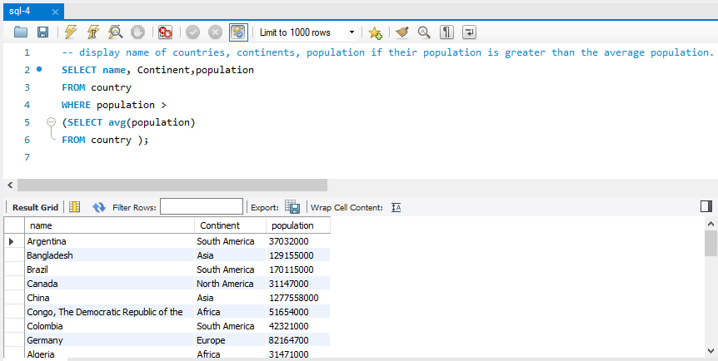
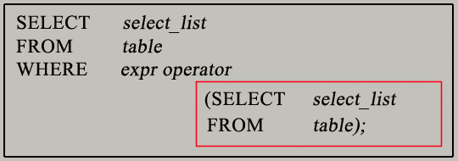
Sub-queries

Slide 9
Stored Procedures
A stored procedure is a prepared SQL code that you can save, so the code can be reused over and over again.
So if you have an SQL query that you write over and over again, save it as a stored procedure, and then just call it to execute it.
You can also pass parameters to a stored procedure, so that the stored procedure can act based on the parameter value(s) that is passed.
Syntax:
CREATE PROCEDURE procedure_name ( ) sql_statement;
CALL procedure_name;

Slide 10
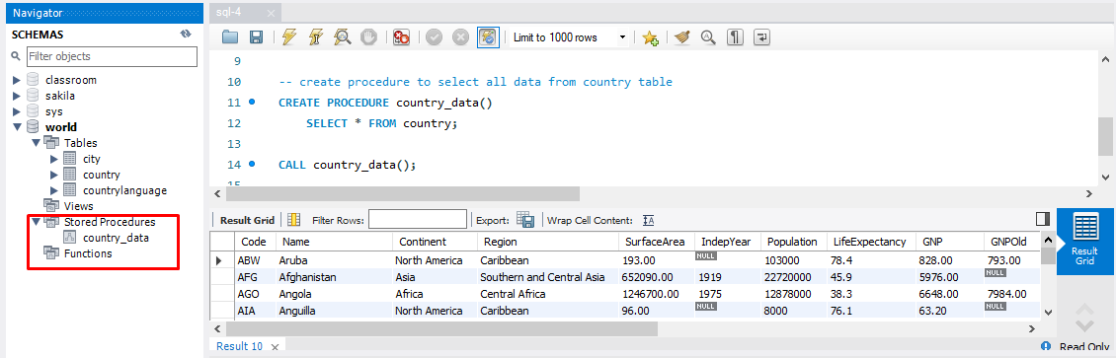
Stored Procedures

Slide 11
VIEWS
In SQL, a view is a virtual table based on the result-set of an SQL statement.
A view contains rows and columns, just like a real table. The fields in a view are fields from one or more real tables in the database.
You can add SQL statements and functions to a view and present the data as if the data were coming from one single table.
A view always shows up-to-date data! The database engine recreates the view, every time a user queries it.
Syntax:
CREATE VIEW view_name AS SELECT column1, column2, ... FROM table_name WHERE condition;

Slide 12
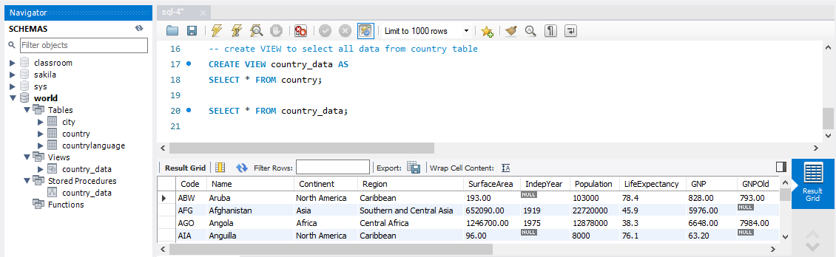
Views

Slide 13
Conditions in SQL
The SQL AND condition and OR Condition can be combined to test for multiple conditions in a where clause.
When combining these conditions, it is important to use parentheses so that the database knows what order to evaluate each condition.
Syntax:
Select column
From table
Where condition1
And condition2
Or condition3;

Slide 14
User-defined functions
The user-defined functions help you simplify your development by encapsulating complex business logic and make them available for reuse in every query.
User-defined scalar functions – cover the user-defined scalar functions that allow you to encapsulate complex formula or business logic and reuse them in every query.
Table variables – learn how to use table variables as a return value of user-defined functions.
Table-valued functions – introduce you to inline table-valued function and multi-statement table-valued function to develop user-defined functions that return data of table types.
Removing user-defined functions – learn how to drop one or more existing user-defined functions from the database.

Slide 15
User-defined functions
Syntax:
CREATE FUNCTION Name(@Parameter_Name Data_type, ....)
RETURNS Data_Type
AS
BEGIN
–- Function_Body
RETURN Data
END

Slide 16
References
https://www.geeksforgeeks.org/sql-ddl-dql-dml-dcl-tcl-commands/#:~:text=DDL%20%E2%80%93%20Data%20Definition%20Language,DML%20%E2%80%93%20Data%20Manipulation%20Language
https://www.w3resource.com/sql/subqueries/understanding-sql-subqueries.php
https://www.w3schools.com/sql/sql_stored_procedures.asp
https://www.w3resource.com/mysql/mysql-procedure.php
https://www.w3schools.com/sql/sql_view.asp
https://www.techonthenet.com/sql/and_or.php

Slide 17
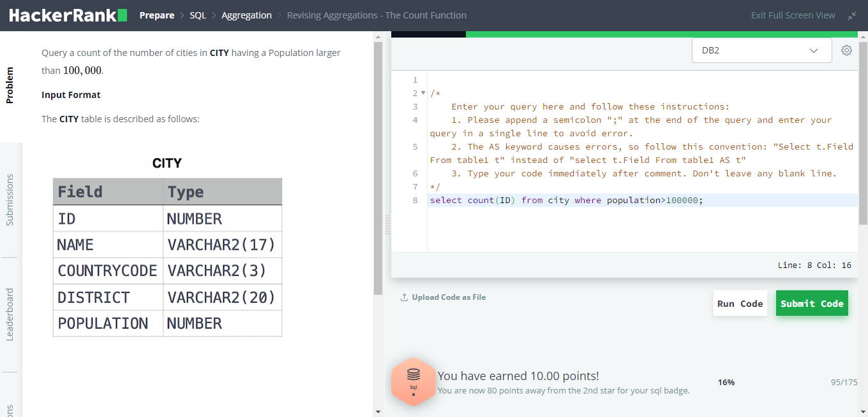
HackerRank Question-1

Slide 18
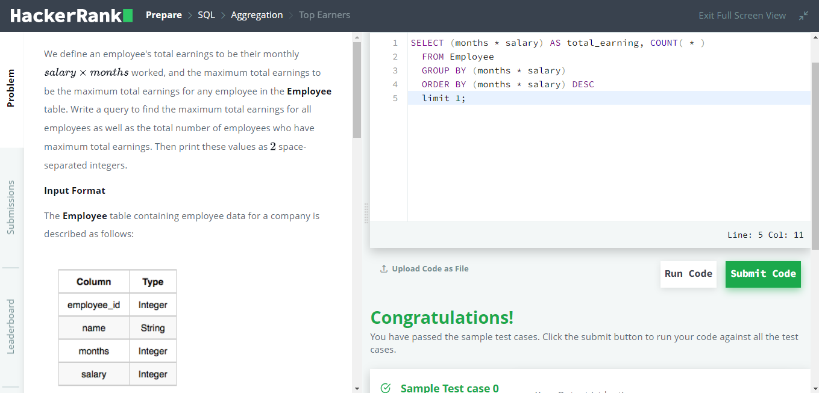
HackerRank Question-2

Slide 19
THE END

